Slide 1
UHackHive
Team Name: NicknShe
Team Members : Nikhil Gupta
Organization: TheMovingCloud

Slide 2
Today’s Agenda
Overview of project
Team details
Architecture / workflow
Supporting document
Technologies used
Additional information

Slide 3
Overview of project
Brief overview covering problem statement or use case

Slide 4

Project Overview
To address the problem of dead stocks and irrelevant shopping spree,
● I am approaching to build a solution that uses automated tagging and tag-based billing dashboard in GCP. This will help local businesses manage their inventory and pricing more effectively, and provide consumers with a better shopping experience.
● I am also planning to restrict incoming traffic to specific locations in GCP to ensure that local businesses are only serving customers in their target audience. This will help reduce the cost of serving customers outside of their target audience and improve the overall efficiency of the solution.
● Finally, I will use Gen-AI based tools to generate a specified virtual marketplace for each customer. This will help customers discover local businesses that stock the products they want, and provide local businesses with more visibility in the market.
● I hope this solution on GCP to bridge the gap between demand and supply in local markets does its intended and make a business out of it.

Slide 5
Architecture / workflow
Architecture / solution diagram and related details

Slide 6
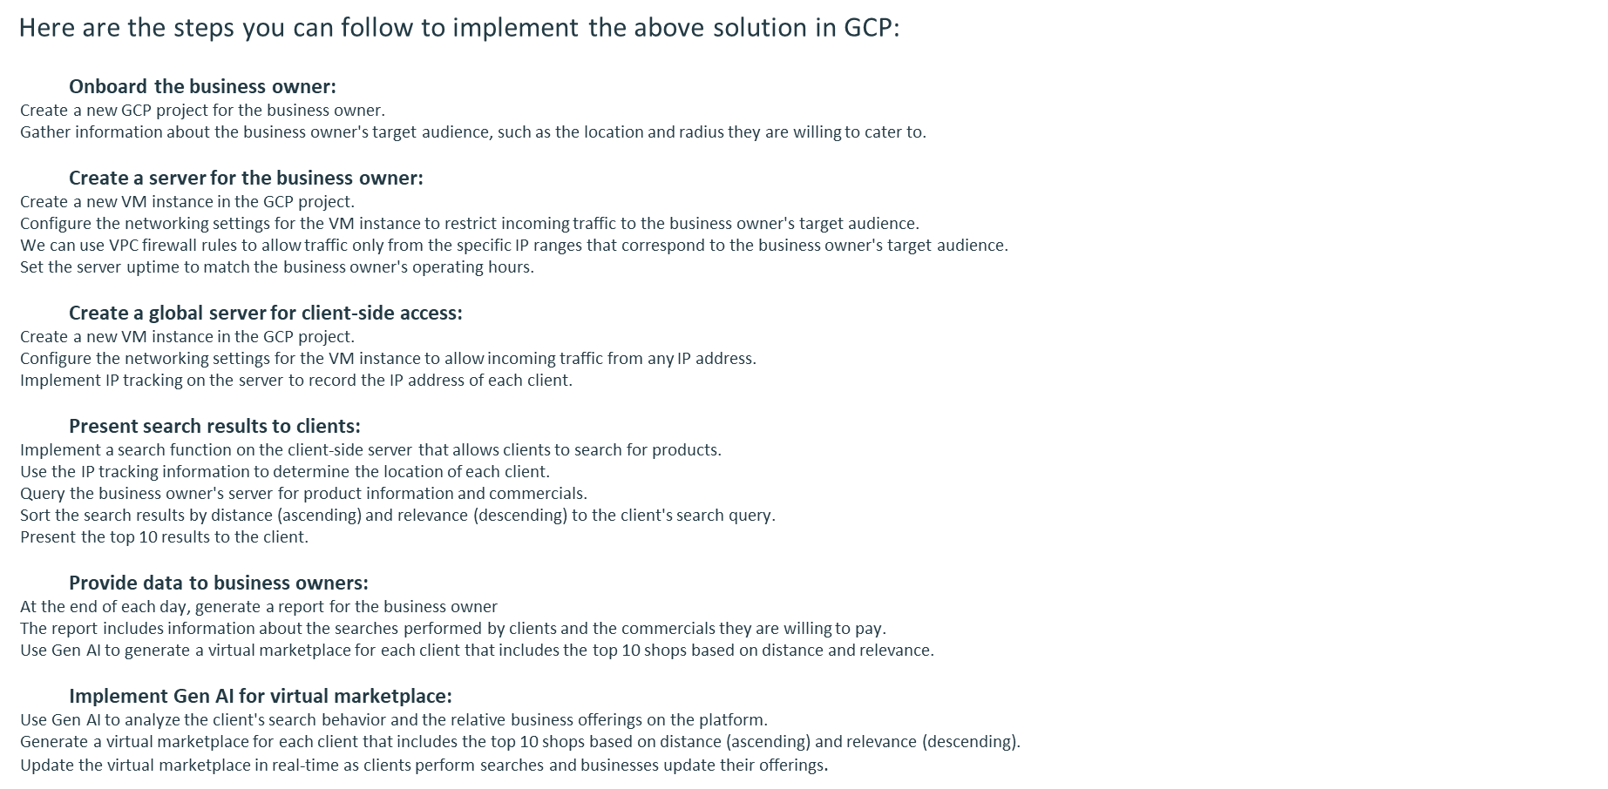

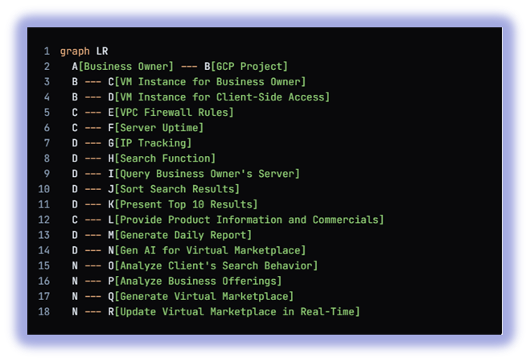

Solution design

Slide 7
Technologies used
Details of technology Stack adopted, covering why a particular tool/technology was selected

Slide 8
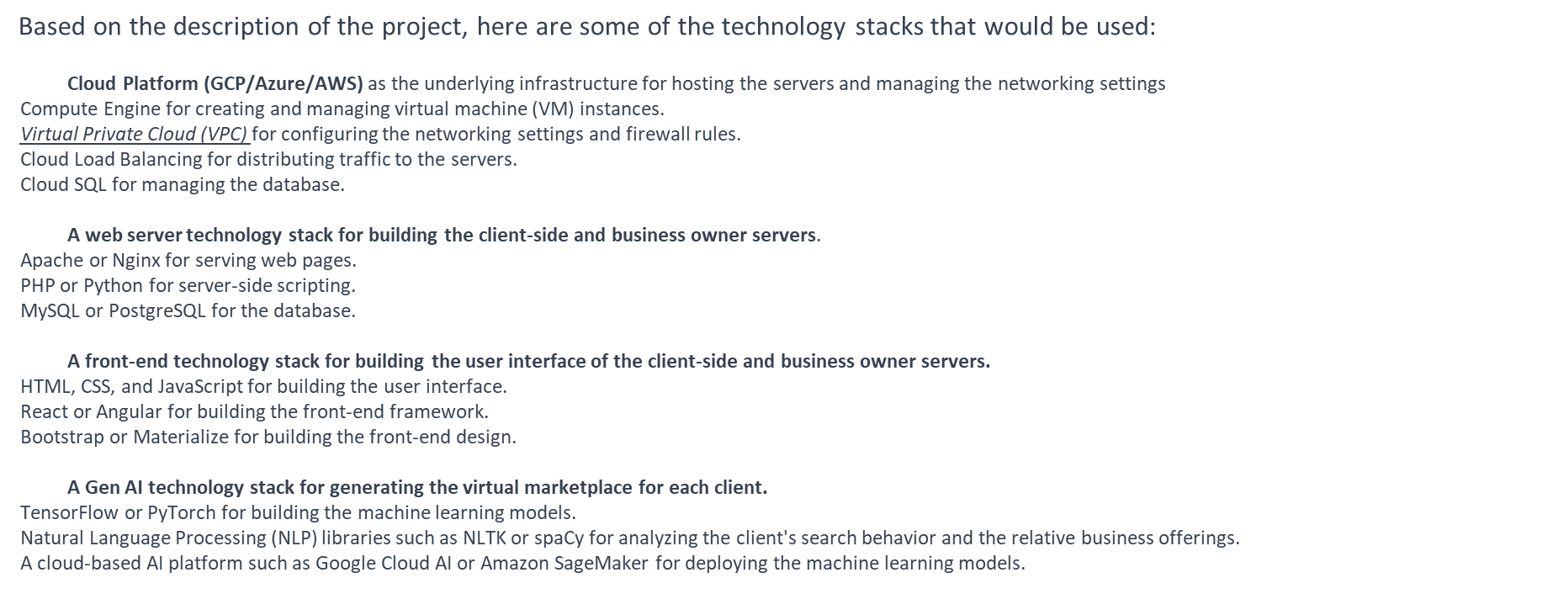

Technology Used

Slide 9
Additional Information
Any additional details not covered in previous slides

Slide 10
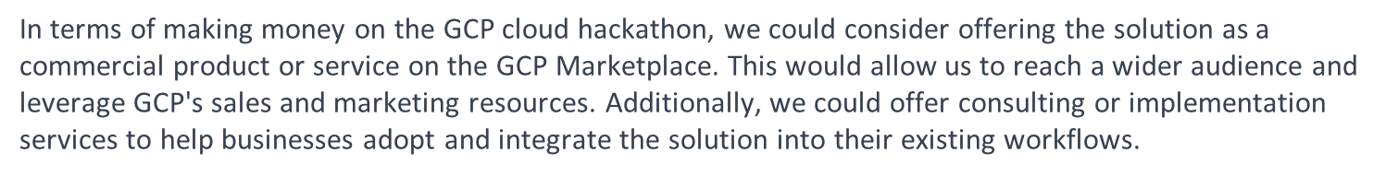
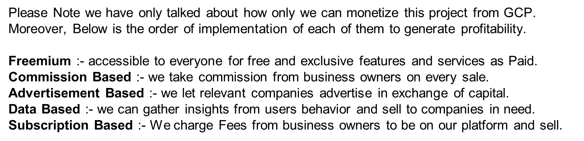
Additional inputs

Slide 11
Team details
Team members’ names, organization, years of experience, skills and location

Slide 12
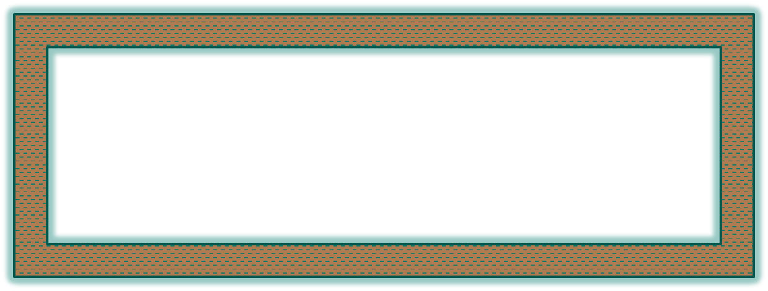
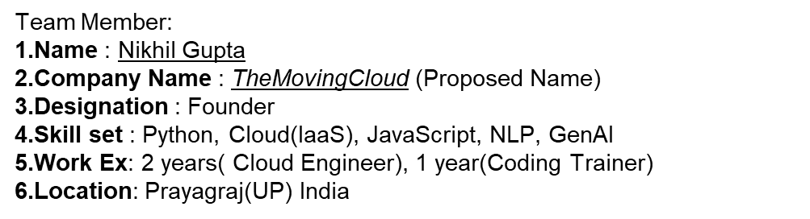
Team Details

Slide 13
Supporting Documents
Links , references etc.

Slide 14
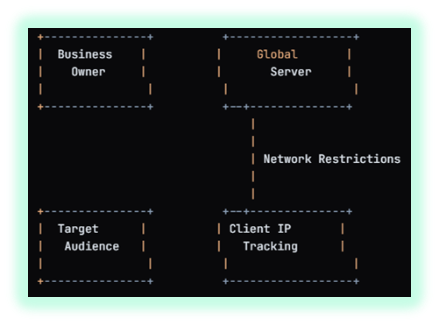
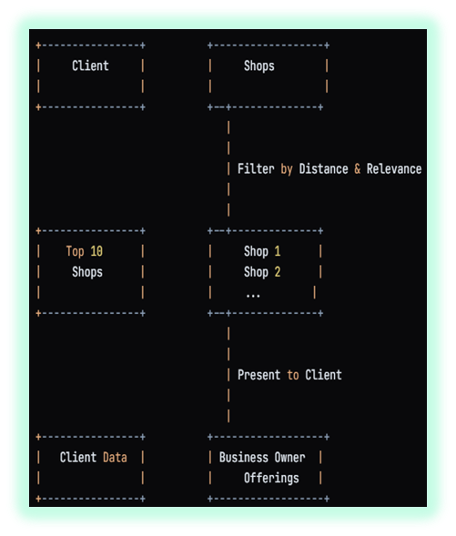
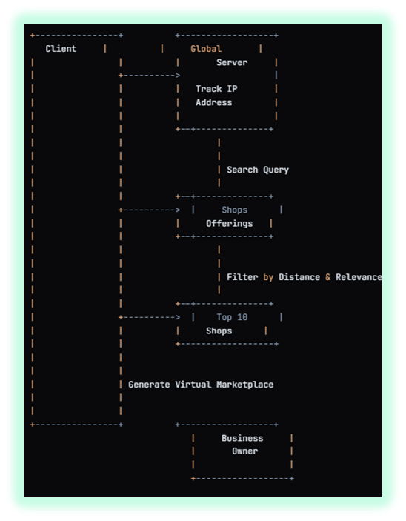




Supporting Link/ Document
Terraform on Google Cloud
Google Cloud Provider for Terraform
Terraform Google Cloud Tagging Module
Terraform Google Cloud Billing Dashboard Module
Terraform Google Cloud Firewall Module
Terraform Google Cloud VPC Module
Terraform Google Cloud Compute Instance Module
Terraform Google Cloud SQL Module
Terraform Google Cloud Storage Module
Terraform Google Cloud IAM Module

Slide 15
Thank you

